Slide 1
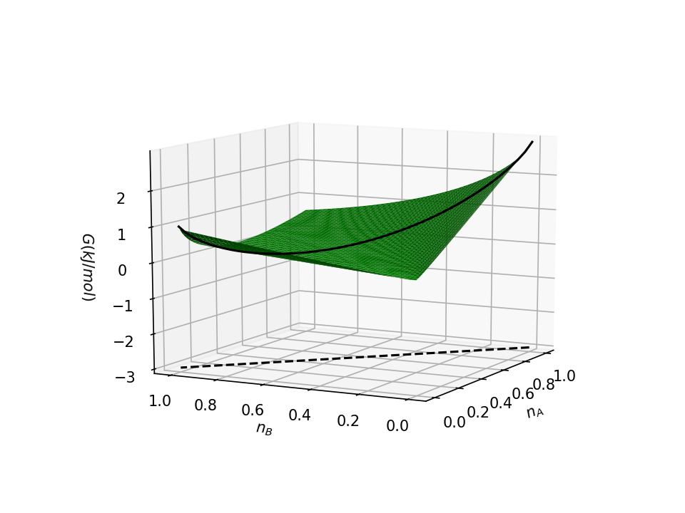
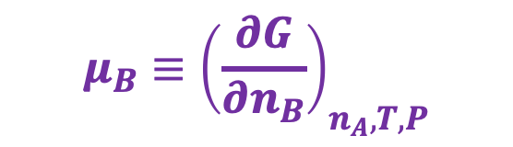
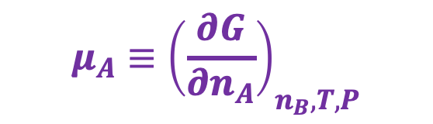
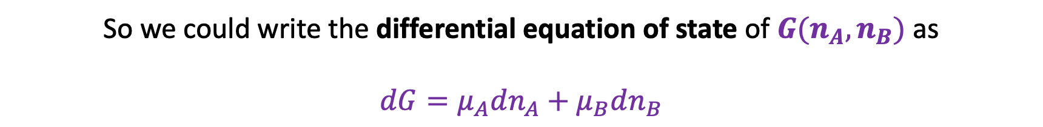
Chemical potentials – they’re just slopes in the $n_{A}$, $n_{B}$ state space
$$μ_{B}≡{\left(\frac{∂G}{∂n_{B}}\right)}_{n_{A}, T,P}$$
$$G(n_{A},n_{B})$$
$$μ_{A}≡{\left(\frac{∂G}{∂n_{A}}\right)}_{n_{B}, T,P}$$
Reaction path
So we could write the differential equation of state of $G(n_{A},n_{B})$ as
$$dG=μ_{A}dn_{A}+μ_{B}dn_{B}$$

Slide 2
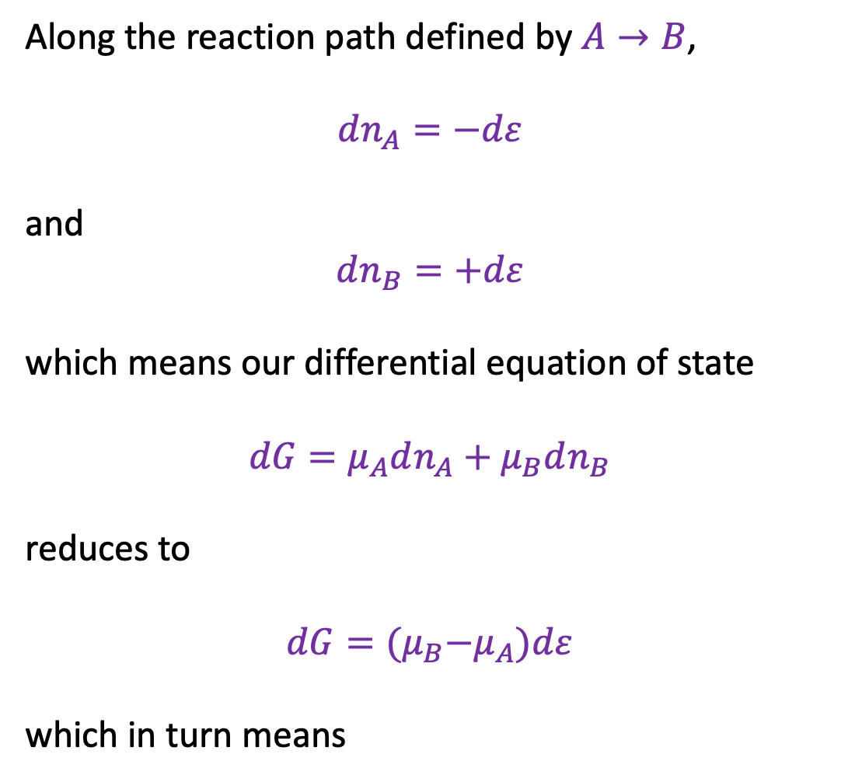


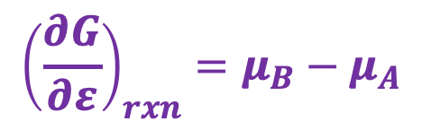
Chemical potentials along a reaction path
Along the reaction path defined by $A→B$,
$dn_{A}=−dε$
and
$$dn_{B}=+dε$$
which means our differential equation of state
$$dG=μ_{A}dn_{A}+μ_{B}dn_{B}$$
reduces to
$$dG={(μ}_{B}−μ_{A})dε$$
which in turn means
$$dn_{A}$$
$$dn_{B}$$
$${\left(\frac{∂G}{∂ε}\right)}_{rxn}=μ_{B}−μ_{A}$$

Slide 3

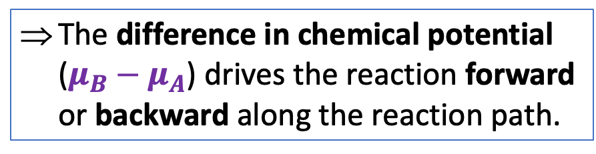
Chemical potentials along a reaction path
Along the reaction path defined by $A→B$,
$dn_{A}=−dε$
and
$$dn_{B}=+dε$$
which means our differential equation of state
$$dG=μ_{A}dn_{A}+μ_{B}dn_{B}$$
reduces to
$$dG={(μ}_{B}−μ_{A})dε$$
which in turn means
$$dn_{A}$$
$$dn_{B}$$
The difference in chemical potential ($μ_{B}−μ_{A}$) drives the reaction forward or backward along the reaction path.
$${\left(\frac{∂G}{∂ε}\right)}_{rxn}=μ_{B}−μ_{A}$$

Slide 4
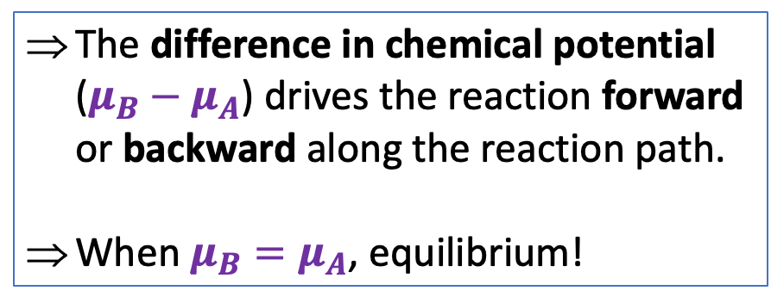
Chemical potentials along a reaction path
Along the reaction path defined by $A→B$,
$dn_{A}=−dε$
and
$$dn_{B}=+dε$$
which means our differential equation of state
$$dG=μ_{A}dn_{A}+μ_{B}dn_{B}$$
reduces to
$$dG={(μ}_{B}−μ_{A})dε$$
which in turn means
$$dn_{A}$$
$$dn_{B}$$
The difference in chemical potential ($μ_{B}−μ_{A}$) drives the reaction forward or backward along the reaction path.
When $μ_{B}=μ_{A}$, equilibrium!
$${\left(\frac{∂G}{∂ε}\right)}_{rxn}=μ_{B}−μ_{A}$$

Slide 5
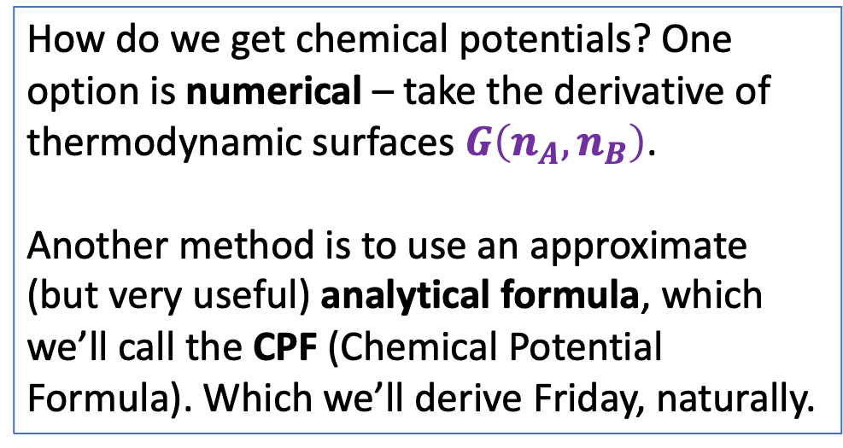
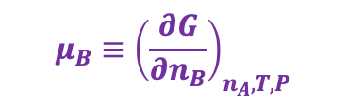
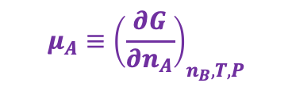
Chemical potentials along a reaction path
How do we get chemical potentials? One option is numerical – take the derivative of thermodynamic surfaces $G\left(n_{A},n_{B}\right)$.
Another method is to use an approximate (but very useful) analytical formula, which we’ll call the CPF (Chemical Potential Formula). Which we’ll derive Friday, naturally.
$$μ_{B}≡{\left(\frac{∂G}{∂n_{B}}\right)}_{n_{A}, T,P}$$
$$G(n_{A},n_{B})$$
$$μ_{A}≡{\left(\frac{∂G}{∂n_{A}}\right)}_{n_{B}, T,P}$$

Slide 6
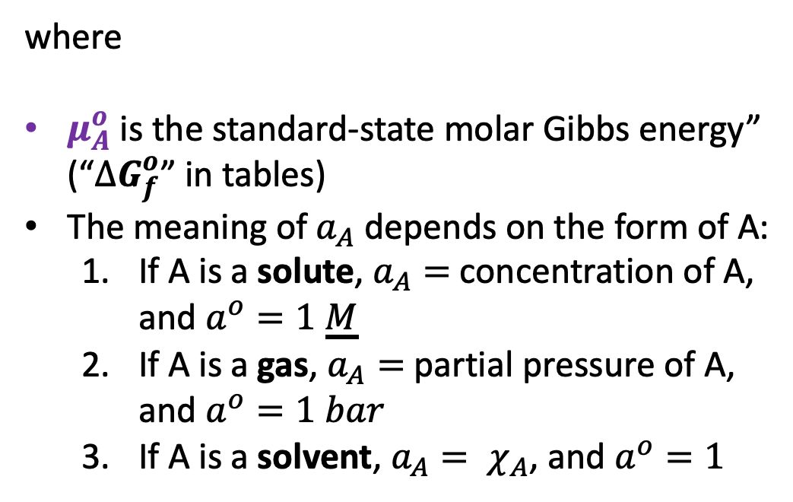
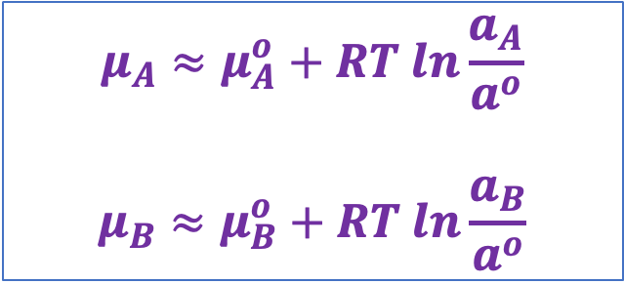
Chemical potentials along a reaction path
$$μ_{A}≈μ_{A}^{o}+RT ln\frac{a_{A}}{a^{o}}$$
$$μ_{B}≈μ_{B}^{o}+RT ln\frac{a_{B}}{a^{o}}$$
The CPF
$$μ_{B}≡{\left(\frac{∂G}{∂n_{B}}\right)}_{n_{A}, T,P}$$
$$G(n_{A},n_{B})$$
where
$μ_{A}^{o}$ is the standard-state molar Gibbs energy” (“${∆G}_{f}^{o}$” in tables)
The meaning of $a_{A}$ depends on the form of A:
If A is a solute, $a_{A}=$ concentration of A, and $a^{o}=1 \underline{M}$
If A is a gas, $a_{A}=$ partial pressure of A, and $a^{o}=1 bar$
If A is a solvent, $a_{A}= χ_{A}$, and $a^{o}=1$
$$μ_{A}≡{\left(\frac{∂G}{∂n_{A}}\right)}_{n_{B}, T,P}$$

Slide 7
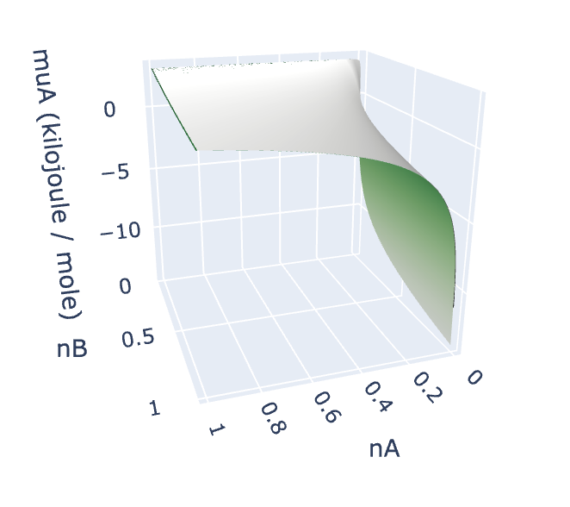
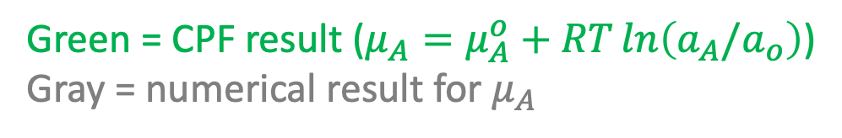
How good is the CPF result?
Green = CPF result ($μ_{A}=μ_{A}^{o}+RT\ln\left(a_{A}/a_{o}\right)$)
Gray = numerical result for $μ_{A}$

Slide 8
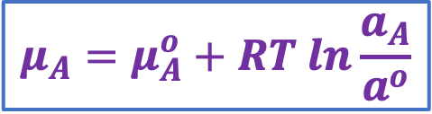
CPF and intuition (A = solute)
$$μ_{A}=μ_{A}^{o}+RT ln\frac{a_{A}}{a^{o}}$$
X
Y
A(aq)
Chamber X: Solute A is highly concentrated
Chamber Y: Solute A is less concentrated
A(aq)
A(aq)
A(aq)
What direction does your intuition tell you is the direction of spontaneous change?

Slide 9
CPF and intuition (A = solute)
$$μ_{A}=μ_{A}^{o}+RT ln\frac{a_{A}}{a^{o}}$$
X
Y
A(aq)
Chamber X: Solute A is highly concentrated
Chamber Y: Solute A is less concentrated
A(aq)
A(aq)
A(aq)
What direction does your intuition tell you is the direction of spontaneous change?

Slide 10
CPF and intuition (A = solute)
$$μ_{A}=μ_{A}^{o}+RT ln\frac{a_{A}}{a^{o}}$$
X
Y
A(aq)
Solutes move from higher concentration to lower concentration
Chamber X: Solute A is highly concentrated
Chamber Y: Solute A is less concentrated
A(aq)
A(aq)
A(aq)
What direction does your intuition tell you is the direction of spontaneous change?

Slide 11
CPF and intuition (A = solute)
$$μ_{A}=μ_{A}^{o}+RT ln\frac{a_{A}}{a^{o}}$$
X
Y
A(aq)
Solutes move from higher concentration to lower concentration
Chamber X: Solute A is highly concentrated
Chamber Y: Solute A is less concentrated
A(aq)
A(aq)
A(aq)
What direction does your intuition tell you is the direction of spontaneous change?
That means $μ_{A}(X)>μ_{A}(Y)$.

Slide 12
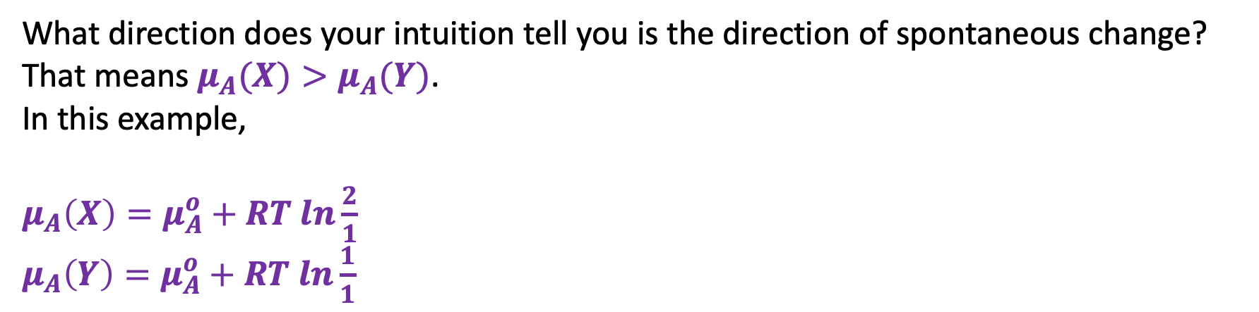


CPF and intuition (A = solute)
$$μ_{A}=μ_{A}^{o}+RT ln\frac{a_{A}}{a^{o}}$$
X
Y
A(aq)
Solutes move from higher concentration to lower concentration
Chamber X: Solute A is highly concentrated
Chamber Y: Solute A is less concentrated
A(aq)
A(aq)
A(aq)
$$a_{A}\left(X\right)=2\underline{M}$$
$$a_{A}\left(Y\right)=1\underline{M}$$
What direction does your intuition tell you is the direction of spontaneous change?
That means $μ_{A}(X)>μ_{A}(Y)$.
In this example,
$μ_{A}\left(X\right)=μ_{A}^{o}+RT ln\frac{2}{1}$
$μ_{A}\left(Y\right)=μ_{A}^{o}+RT ln\frac{1}{1}$

Slide 13

CPF and intuition (A = solute)
$$μ_{A}=μ_{A}^{o}+RT ln\frac{a_{A}}{a^{o}}$$
X
Y
A(aq)
Solutes move from higher concentration to lower concentration
Chamber X: Solute A is highly concentrated
Chamber Y: Solute A is less concentrated
A(aq)
A(aq)
A(aq)
$$a_{A}\left(X\right)=2\underline{M}$$
$$a_{A}\left(Y\right)=1\underline{M}$$
What direction does your intuition tell you is the direction of spontaneous change?
That means $μ_{A}(X)>μ_{A}(Y)$.
In this example,
$μ_{A}\left(X\right)=μ_{A}^{o}+RT ln\frac{2}{1}$
$μ_{A}\left(Y\right)=μ_{A}^{o}+RT ln\frac{1}{1}$
$μ_{A}(X)>μ_{A}(Y)$

Slide 14

CPF and intuition (A = solute)
$$μ_{A}=μ_{A}^{o}+RT ln\frac{a_{A}}{a^{o}}$$
X
Y
A(aq)
Solutes move from higher concentration to lower concentration
Chamber X: Solute A is highly concentrated
Chamber Y: Solute A is less concentrated
A(aq)
A(aq)
A(aq)
$$a_{A}\left(X\right)=\underline{2M}$$
$$a_{A}\left(Y\right)=1\underline{M}$$
What direction does your intuition tell you is the direction of spontaneous change?
That means $μ_{A}(X)>μ_{A}(Y)$.
In this example,
$μ_{A}\left(X\right)=μ_{A}^{o}+RT ln\frac{2}{1}$
$μ_{A}\left(Y\right)=μ_{A}^{o}+RT ln\frac{1}{1}$
Solutes move from higher chemical potential to lower chemical potential
$μ_{A}(X)>μ_{A}(Y)$

Slide 15

CPF and intuition (A = solute)
$$μ_{A}=μ_{A}^{o}+RT ln\frac{a_{A}}{a^{o}}$$
X
Y
A(aq)
Solutes move from higher concentration to lower concentration
Chamber X: Solute A is highly concentrated
Chamber Y: Solute A is less concentrated
A(aq)
A(aq)
A(aq)
$$a_{A}\left(X\right)=2\underline{M}$$
$$a_{A}\left(Y\right)=1\underline{M}$$
What direction does your intuition tell you is the direction of spontaneous change?
That means $μ_{A}(X)>μ_{A}(Y)$.
In this example,
$μ_{A}\left(X\right)=μ_{A}^{o}+RT ln\frac{2}{1}$
$μ_{A}\left(Y\right)=μ_{A}^{o}+RT ln\frac{1}{1}$
$μ_{A}\left(Y\right)−μ_{A}\left(X\right)≡{∆μ}_{A}$

Slide 16
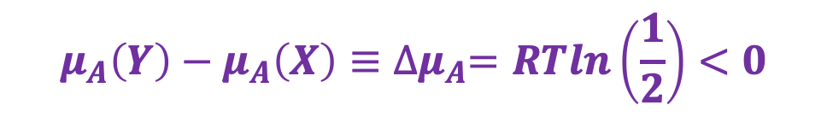
CPF and intuition (A = solute)
$$μ_{A}=μ_{A}^{o}+RT ln\frac{a_{A}}{a^{o}}$$
X
Y
A(aq)
Solutes move from higher concentration to lower concentration
Chamber X: Solute A is highly concentrated
Chamber Y: Solute A is less concentrated
A(aq)
A(aq)
A(aq)
$$a_{A}\left(X\right)=2\underline{M}$$
$$a_{A}\left(Y\right)=1\underline{M}$$
What direction does your intuition tell you is the direction of spontaneous change?
That means $μ_{A}(X)>μ_{A}(Y)$.
In this example,
$μ_{A}\left(X\right)=μ_{A}^{o}+RT ln\frac{2}{1}$
$μ_{A}\left(Y\right)=μ_{A}^{o}+RT ln\frac{1}{1}$
$$μ_{A}\left(Y\right)−μ_{A}\left(X\right)≡{∆μ}_{A}=RTln\left(\frac{1}{2}\right)<0$$

Slide 17


CPF and intuition (A = gas)
$$μ_{A}=μ_{A}^{o}+RT ln\frac{a_{A}}{a^{o}}$$
X
Y
Chamber X: Pure oxygen gas
Chamber Y: Air
O₂(g)
O₂(g)
N₂(g)
$$P_{O_{2}}=1. 00 bar$$
$$P_{O_{2}}=0.21 bar$$
What direction does your intuition tell you is the direction of spontaneous change?

Slide 18
CPF and intuition (A = gas)
$$μ_{A}=μ_{A}^{o}+RT ln\frac{a_{A}}{a^{o}}$$
X
Y
Chamber X: Pure oxygen gas
Chamber Y: Air
O₂(g)
O₂(g)
N₂(g)
$$P_{O_{2}}=1. 00 bar$$
$$P_{O_{2}}=0.21 bar$$
What direction does your intuition tell you is the direction of spontaneous change?

Slide 19
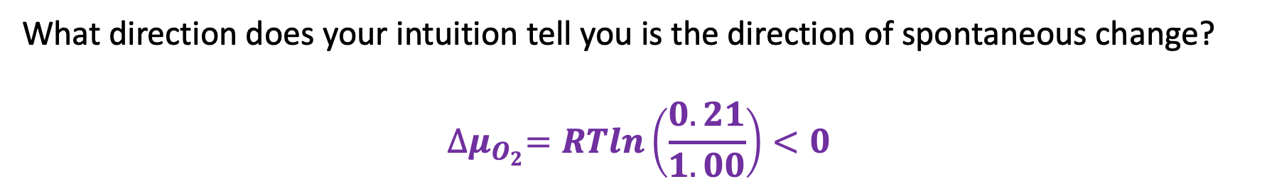
CPF and intuition (A = gas)
$$μ_{A}=μ_{A}^{o}+RT ln\frac{a_{A}}{a^{o}}$$
X
Y
Chamber X: Pure oxygen gas
Chamber Y: Air
O₂(g)
O₂(g)
N₂(g)
$$P_{O_{2}}=1. 00 bar$$
$$P_{O_{2}}=0.21 bar$$
What direction does your intuition tell you is the direction of spontaneous change?
$${∆μ}_{O_{2}}=RTln\left(\frac{0.21}{1.00}\right)<0$$

Slide 20
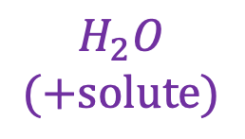
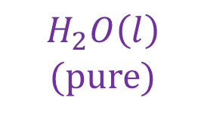
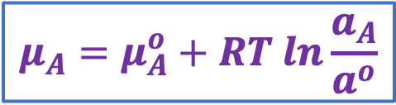
CPF and intuition (A = solvent)
Chamber X is a 1 M solution of NaCl(aq). Chamber Y is pure water.
X
Y
$$H_{2}O$$
$$(+solute)$$
$$H_{2}O\left(l\right)$$
$$(pure)$$
What direction does your intuition tell you is the direction of spontaneous change?
$$μ_{A}=μ_{A}^{o}+RT ln\frac{a_{A}}{a^{o}}$$

Slide 21
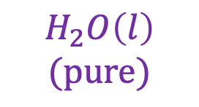

CPF and intuition (A = solvent)
Chamber X is a 1 M solution of NaCl(aq). Chamber Y is pure water.
X
Y
Solvents move move from the pure-solvent side to the side with solutes in it
$$H_{2}O$$
$$(+solute)$$
$$H_{2}O\left(l\right)$$
$$(pure)$$
What direction does your intuition tell you is the direction of spontaneous change?
$$μ_{A}=μ_{A}^{o}+RT ln\frac{a_{A}}{a^{o}}$$

Slide 22
CPF and intuition (A = solvent)
Chamber X is a 1 M solution of NaCl(aq). Chamber Y is pure water.
X
Y
Solvents move move from the pure-solvent side to the side with solutes in it
$$H_{2}O$$
$$(+solute)$$
$$H_{2}O\left(l\right)$$
$$(pure)$$
What direction does your intuition tell you is the direction of spontaneous change?
That means $μ_{A}(Y)>μ_{A}(X)$.
$$μ_{A}=μ_{A}^{o}+RT ln\frac{a_{A}}{a^{o}}$$

Slide 23

CPF and intuition (A = solvent)
Chamber X is a 1 M solution of NaCl(aq). Chamber Y is pure water.
$$∆P$$
Y
X
We could apply extra pressure $∆P$ to compensate
$$H_{2}O$$
$$(+solute)$$
$$H_{2}O\left(l\right)$$
$$(pure)$$
What direction does your intuition tell you is the direction of spontaneous change?
That means $μ_{A}(Y)>μ_{A}(X)$.
$$μ_{A}=μ_{A}^{o}+RT ln\frac{a_{A}}{a^{o}}$$

Slide 24
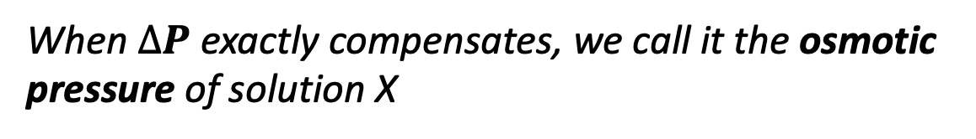
CPF and intuition (A = solvent)
Chamber X is a 1 M solution of NaCl(aq). Chamber Y is pure water.
$$∆P$$
Y
X
When $∆P$ exactly compensates, we call it the osmotic pressure of solution X
$$H_{2}O$$
$$(+solute)$$
$$H_{2}O\left(l\right)$$
$$(pure)$$
What direction does your intuition tell you is the direction of spontaneous change?
That means $μ_{A}(Y)>μ_{A}(X)$.
$$μ_{A}=μ_{A}^{o}+RT ln\frac{a_{A}}{a^{o}}$$

Slide 25
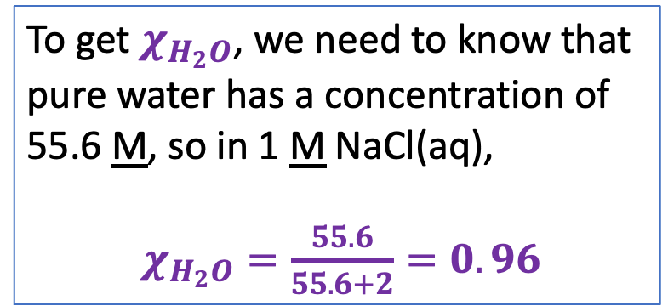
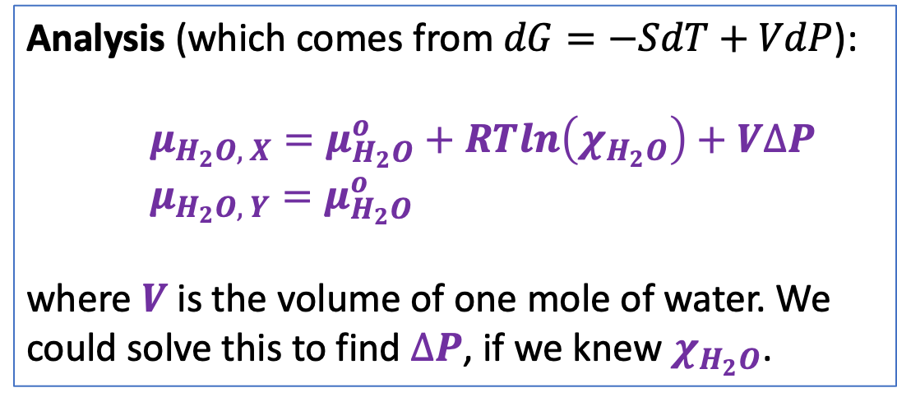
CPF and intuition (A = solvent)
Chamber X is a 1 M solution of NaCl(aq). Chamber Y is pure water.
$$∆P$$
Y
X
When $∆P$ exactly compensates, we call it the osmotic pressure of solution X
$$H_{2}O$$
$$(+solute)$$
$$H_{2}O\left(l\right)$$
$$(pure)$$
Analysis (which comes from $dG=−SdT+VdP$):
$μ_{H_{2}O, X}=μ_{H_{2}O}^{o}+RTln\left(χ_{H_{2}O}\right)+V∆P$
$μ_{H_{2}O, Y}=μ_{H_{2}O}^{o}$
where $V$ is the volume of one mole of water. We could solve this to find $∆P$, if we knew $χ_{H_{2}O}$.
To get $χ_{H_{2}O}$, we need to know that pure water has a concentration of 55.6 M, so in 1 M NaCl(aq),
$χ_{H_{2}O}=\frac{55.6}{55.6+2}=0.96$

Slide 26
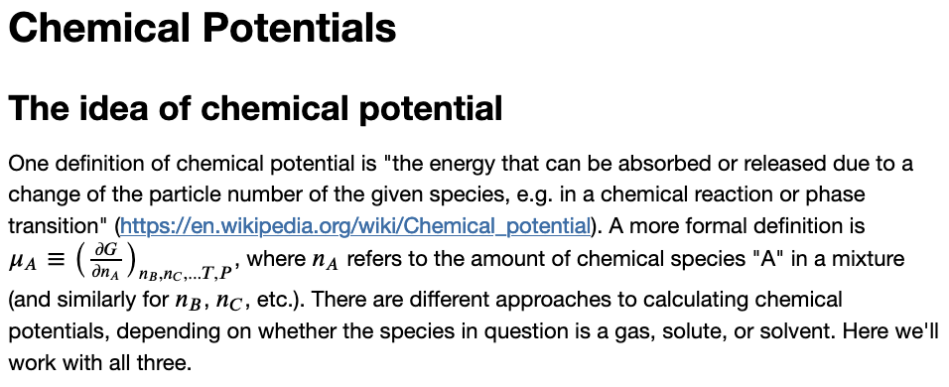
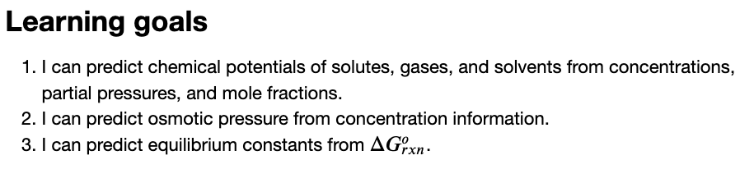
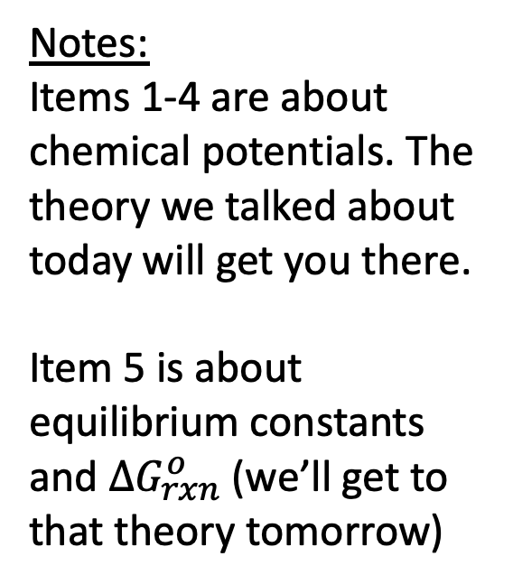
The CGI associated with this
Notes:
Items 1-4 are about chemical potentials. The theory we talked about today will get you there.
Item 5 is about equilibrium constants and $∆G_{rxn}^{o}$ (we’ll get to that theory tomorrow)

